Slide 1

Category Code: C3
Problem Statement Title: FinEase: AI-Powered Autonomous Finance for Small Businesses
Team Name: Team INSPIRE
Institute Name: Vivekanand Education Society’s Institute of Technology

Slide 2

Idea / Approach details
Problem Statement:
Target Users (Who will use it?) :
🔹 Small & Medium Enterprises (SMEs) –
Businesses that need automated invoicing and
payment tracking. 🔹 Freelancers & Consultants – Individuals
managing their own finances and payments. 🔹 Large Enterprises – Companies integrating
with QuickBooks, Xero, or Zoho Books. 🔹 Accountants & Financial Advisors –
Professionals who manage multiple client
accounts.
🔹 Small businesses struggle with financial
tracking, late payments, and debt risks.
🔹Traditional tools lack AI-driven insights for
smarter financial decisions.
Our Solution :
🔹 AI-powered financial tracking with real-time
updates.
🔹 Automated invoice generation & reminders
(email, WhatsApp, SMS).
🔹 Debt risk detection & priority-based payment
suggestions.
🔹 Predictive cash flow analysis using VectorDB
& AI.

Slide 3
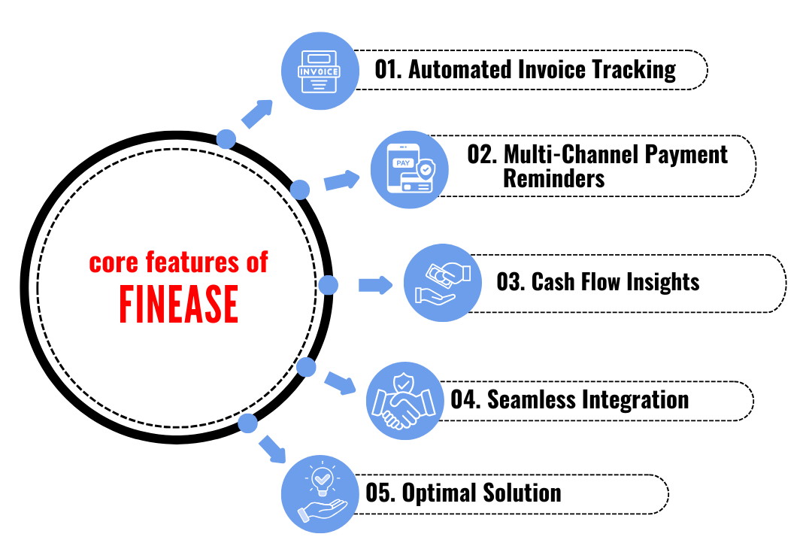
Implemented Features
Implemented Features :
🔹 Automated Invoice Tracking – AI fetches
invoices from accounting tools, extracts key details,
and categorizes them as Paid, Due, or Overdue.
🔹 Group Users Retrieval (Overdue, Paid, Unpaid) -
Segments users based on payment status, enabling
targeted follow-ups and financial insights.
🔹 Automated Reminders (Email) – Sends smart,
multi-channel reminders to overdue payers, reducing
missed payments and improving cash flow.
🔹 Cash Flow Insights – AI analyzes income and
expenses, forecasts trends, and provides actionable
financial insights for better decision-making.

Slide 4
Innovation & Technologies Used
Tech Stack :
Feature | Traditional Accounting Apps | FinEase
Invoice Tracking | Manual logging | Automated fetching & overdue detection
Reminders | Basic alerts | Smart multi-channel reminders (SMS, Email, WhatsApp, Slack)
Cash Flow Analysis | Manual input | AI-driven financial insights & forecasting
Integration | Limited | Seamless sync with QuickBooks, Xero, Zoho Books
Autonomy | User-dependent | AI-powered financial assistant
🔹 GenAI Models – GPT-4o for
AI-powered financial insights
🔹 Uptiq AI Workbench – For agent
creation & workflow automation
🔹 Vector DBs – For data storage and
transaction tracking
🔹 Twilio / Meta API – For SMS,
WhatsApp, and email notifications
🔹 Razorpay / PayPal API – For
automated supplier payments

Slide 5
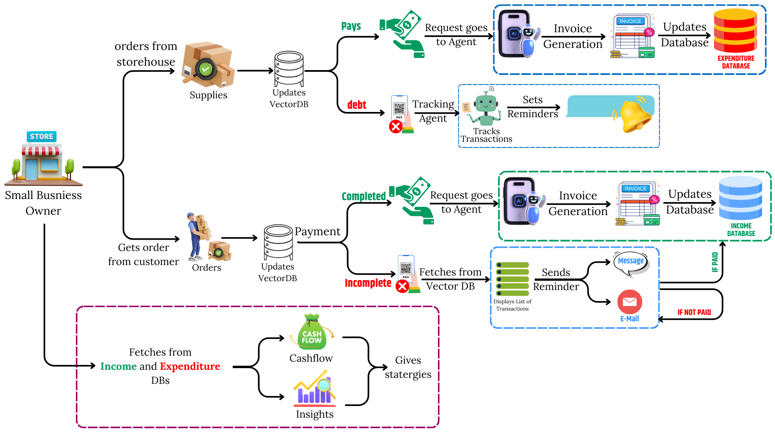
Flow Diagram/Architecture/Use Case Diagram
Use Case Diagram
Documentation: Link

Slide 6
Demo video Link & Statistics
Demo Video Link : Link
CookBook Link : Link
Feature | Traditional Accounting Apps | FinEase
Invoice Processing Time | 7 to 13 days | 3 to 4 days , where 50% or greater time savings than manual .
Accuracy | Between 0.04% to 12% error rate | 75% percent fewer error rates.
Cost Report | High costings | 78.8 - 83% cost reduction.
Savings | Approx. ₹110 per invoice | Approx. ₹40 per invoice , reduce costs by 60% to 90%
Cash Flow Forecasting | Approx 72% data is manually collected so high error rates. | 20% improvement in forecasting accuracy.
Environmental Impact | 70% of paper invoices used | Minimal paper usage (approx. < 10% )

Slide 7
Future Scope
Seamless User Authentication – Enable login via OAuth (Google, QuickBooks, Xero, etc.) or manual registration for a frictionless onboarding experience.
Voice-Enabled Financial Assistant – Allow users to query reports, track invoices, and receive insights through voice assistants for hands-free convenience.
Customizable Payment Workflows – Businesses can set tailored rules for reminders, follow-ups, and invoice tracking to fit their financial operations.
Automated Payments via Gateways – Integrate UPI, Stripe, Razorpay, and more to facilitate direct, automated invoice payments and reduce delays.

